Slide 1
Basic Database concepts with SQL Server
Md. Khairul Alam MCTS, MCPD, CSM
Software Engineer
DataSoft Systems Bangladesh Limited

Slide 2
What is Data ?
Data are the facts or details from which information is derived.
Individual pieces of data are rarely useful alone.
For data to become information, data needs to be put into context.

Slide 3
Data vs Information
Data | Information
Data is raw, unorganized facts that need to be processed. Data can be something simple and seemingly random and useless until it is organized. | When data is processed, organized, structured or presented in a given context so as to make it useful, it is called information.
Each student's test score is one piece of data. | The average score of a class or of the entire school is information that can be derived from the given data.
"Data" comes from a singular Latin word, datum, which originally meant "something given." Its early usage dates back to the 1600s. Over time "data" has become the plural of datum. | "Information" is an older word that dates back to the 1300s and has Old French and Middle English origins. It has always referred to "the act of informing, " usually in regard to education, instruction, or other knowledge communication.

Slide 4
Data Types
Three concepts come with data :
structured, semi structured and unstructured data.
Structured Data:
It concerns all data which can be stored in RDBMS in table with rows and columns.
They have relational key and can be easily mapped into pre-designed fields. Today, those data are the most processed in development and the simplest way to manage information.
But structured data represent only 5 to 10% of all informatics data.

Slide 5
Data Types
Semi structured data:
Semi-structured data is information that doesn’t reside in a relational database but that does have some organizational properties that make it easier to analyze. With some process you can store them in relation database (it could be very hard for some kind of semi structured data), but the semi structure exist to ease space, clarity or compute…
Examples of semi-structured : CSV, XML and JSON documents are semi structured documents, NoSQL databases are considered as semi structured.
But as Structured data, semi structured data represents a few parts of data (5 to 10%) so the last data type is the strongest.

Slide 6
Data Types
Unstructured data:
Unstructured data represent around 80% of data. It often include text and multimedia content. Examples include:
E-mail messages, word processing documents, videos, photos,
audio files, presentations, webpages and many other kinds of
business documents.
Big Data management systems as well as NoSQL databases are considerate to handle unstructured data .
Hadoop has become the de facto industry standard for managing Big Data.

Slide 7
Data processing
What are the steps the may occur in systematic data processing?
Any data processing system may use all or a subset of the activities given below
1. Collection of Data
2. Recording of Data
3. Sorting of Data
4. Data Classification
5. Calculation
6. Retrieval of data
7. Summarizing
8. Communicating

Slide 8
Data processing
What are the major data processing models?
1. Batch processing:
In this model, transactions are collected in a group and processed together.
2. On-line(interactive) processing
In this model, transactions are processed as and when they appear.
3. Real-time processing
It is a parallel time relationship with on-going activity and the current activity is controlled by the information produced.

Slide 9
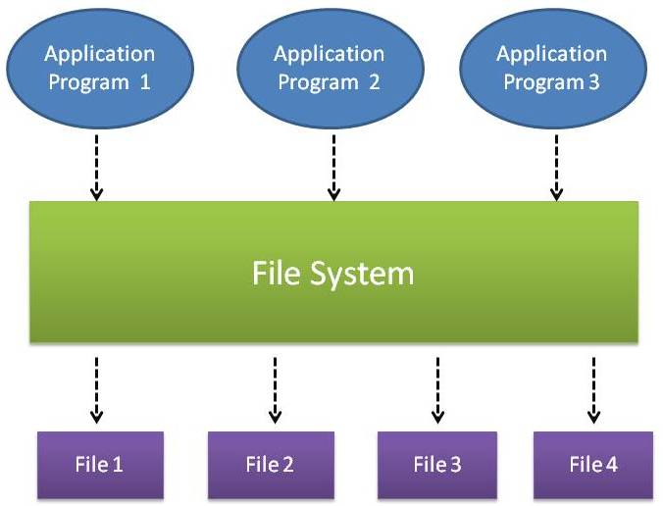
Traditional Data Storage Model
How data is stored in flat files • Data is stored in flat files as records. • Records consist of various fields which are delimited by a space, comma, pipe, any special character etc. • End of records and end of files will be marked using any predetermined character set or special characters in order to identify them.

Slide 10
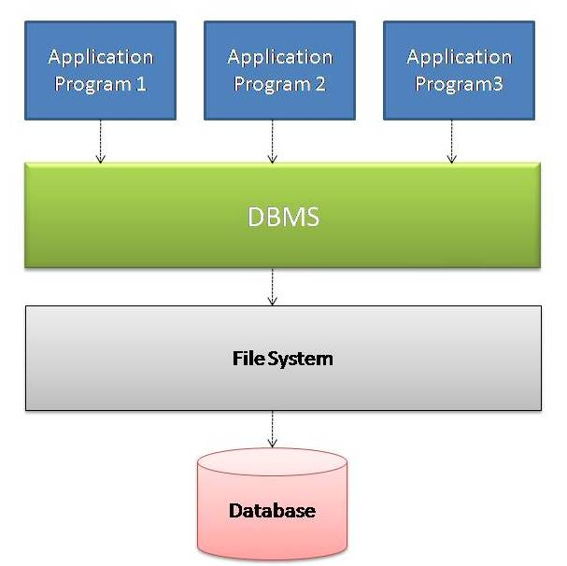
Introduction to Database Technology and DBMS
What is Database? Database is a computer based record keeping system which is used to record ,maintain and retrieve data. It is an organized collection of interrelated (persistent) data. What is Database Management System (DBMS)? A Database Management System (DBMS) is a collection of interrelated files and set of programs which allows users to access and modify files. It provides a convenient and efficient way to store, retrieve and modify information. Application programs request DBMS to retrieve, modify/insert/delete data for them and thus it acts as a layer of abstraction between the application programs and the file system.

Slide 11
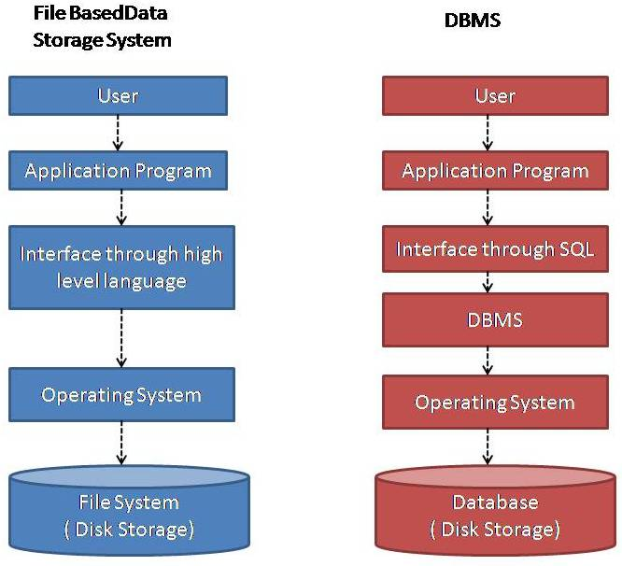
Difference Between File based Data Storage System and DBMS

Slide 12
RDBMS vs NoSQL vs Hadoop
RDBMS | NoSQL | Hadoop
Schema based. Data integrity is due to its adherence to ACID (atomicity, consistency, isolation, and durability) principles. | NoSQL Databases offered an alternative by eliminating schemas at the expense of relaxing ACID principles. NoSQL databases are either document-based, key-value pairs, graph databases or wide-column stores | It’s a file system and not a database.
Uses structured query language (SQL) for defining and manipulating data. | Now that many NoSQL databases achieve their (com)promises, many, if not most, are going back to an SQL-like dialect, to grow their user base with users already familiar with SQL. CQL (Cassandra Query Language), Spark, Hive, or Presto are all notable examples. Elasticsearch has its own SQL variant. So does MongoDB. Even streaming platforms like Kafka are getting in on the SQL act! | MapReduce (Hadoop Map/Reduce) is a software framework for distributed processing of large data sets on compute clusters of commodity hardware
SQL Server, Oracle, MySQL, PostgreSQL etc. | MongoDB, CouchDB, Cassandra etc. | Hadoop and associates (HBase, MapReduce, Hive, Pig, Zookeeper)

Slide 13
RDBMS
Oracle:
-Closed-source; free version has very limited feature set .
-Temporary tables persist across sessions, and must be removed by the user.
-Support for four different character/string types: CHAR, VARCHAR2,NCHAR, cdNVARCHAR2
-Offers both table and row locking
-Extensive and flexible storage customization with commands like tablespace, synonym, cdand packages
-Extensive backup mechanisms
-Designed to manage tables and databases on a large-scale basis

Slide 14
RDBMS
MySQL
-Open-source, Compatible with a wide range of engines and interfaces;
-One of the most mature databases on the market ;Lightweight
-One of the most popular database tools; easy to find support online.
-Temporary tables are only visible within the current active session, and are removed automatically afterwards.
-Lacks ACID compliance, Can partition tables via LIST, HASH, RANGE, and SET Support for two different character/string types: CHAR and VARCHAR.
-Offers only table locking, Lacks options for table views , Limited storage customization.
-Admin tools are incredibly powerful.
-Backup mechanisms: mysqlhotcopy and mysqldump
-Experiences significant performance degradation at high scale.
-Provides little in the way of performance optimization Issues with reliability.
-Limited security compared to some other database systems.
-Designed for transactional workloads, and as such is ill-suited for analytical workloads

Slide 15
RDMBS
PostgreSQL:
Open-source
Adheres well to current SQL standards, and easier to learn as a result
Large footprint makes it ill-suited for read-heavy operations
Advanced business/location analytics features
Rich variety of data and character types
Fully ACID-compliant.
Designed for reliability and data-integrity; developer-focused
Full-text search, support for powerful server-side procedural languages
Full support for advanced SQL features such as table expressions and window functions
Can efficiently join large numbers of tables
Replication is poorly-implemented
Not well-suited for low-concurrency projects

Slide 16
RDMBS
MS SQL Server
Closed-source, aimed at corporate/enterprise environments.
Offers full support for common table expressions
Requires a deeper understanding of databases/database configuration than other tools
Can fine-tune security features, such as who can run each stored procedure, who can access data, etc.
Utilizes an engine that’s slightly slower and resource-heavy, but fully ACID compliant.
Extremely comprehensive reporting system/storage customization
High degree of control over transactions and procedures
Offers more than simple database functionality through a suite of tools: an ETL tool SSIS, analytical tool SSAS, Reporting tool SSRS and management tool SSMS.
Schema changes do not lock tables.

Slide 17
SQL Server Versions
2000
2005
2008
2008 R2
2012
2014
2016
2017
2019 (CTP)

Slide 18
SQL Server Editions
Enterprise
Standard
Web
Developer
Express editions

Slide 19
Features Supported by SQL Server
SQL Server editions Using SQL Server with an Internet Server Using SQL Server with client/server applications Deciding among SQL Server components Scale limits RDBMS high availability RDBMS scalability and performance RDBMS security Replication Management tools RDBMS manageability Development tools Programmability | Integration Services Master Data Services Data warehouse Analysis Services BI semantic model (Multi Dimensional) BI semantic model (Tabular) Power Pivot for SharePoint Data mining Reporting Services Business intelligence clients Spatial and location services Additional database services Other component

Slide 20
What’s new in Microsoft SQL Server 2017
SQL Server on Linux Resumable online index rebuild SQL Server machine learning services Query processing improvements Automatic database tuning TempDB file size improvements Smart differential backup | Smart transaction log backup Improved SELECT INTO statement Distributed transaction support New availability groups functionality New dynamic management views In-memory enhancements Security enhancement High availability and disaster recovery Performance improvements

Slide 21
SQL Server Management Studio components and configuration
Object Explorer (F8)
Object Explorer Details (F7)
Query Window (Ctrl+N)
Properties (F4)
Template Browser (Ctrl+Alt+T)
SQL Server Agent
SQL Server Profiler
Security
Execution Plan
SQL Server Configuration Manager
Tips and Tricks for using SSMS
Others

Slide 22
Data model
--Managing large quantities of structured and unstructured data is a primary function of information systems.
--Describe the structure, manipulation and integrity aspects of the data stored in data management systems such as relational databases.
A data model instance may be one of three kinds according to ANSI in 1975.
Conceptual Data Model (CDM)
Logical Data Model (LDM)
Physical Data Model (PDM)

Slide 23
Data Model
CDM | LDM | PDM
Includes high-level data constructs | Includes entities (tables), attributes (columns/fields) and relationships (keys) | Includes tables, columns, keys, data types, validation rules, database triggers, stored procedures, domains, and access constraints
Non-technical names, so that executives and managers at all levels can understand the data basis of Architectural Description | Uses business names for entities & attributes | Uses more defined and less generic specific names for tables and columns, such as abbreviated column names, limited by the database management system (DBMS) and any company defined standards
Uses general high-level data constructs from which Architectural Descriptions are created in non-technical terms | Independent of technology (platform, DBMS) | Includes primary keys and indices for fast data access.
May not be normalized | Normalized to fourth normal form (4NF) | May be de-normalized . If the nature of the database is Online Transaction Processing (OLTP) or Operational Data Store (ODS) it is usually not de-normalized.

Slide 24
Database model
A database model is a type of data model that determines:
--The logical structure of a database
--Fundamentally determines in which manner data can be stored, organized and manipulated.
The most popular example of a database model is:
--The relational model, which uses a table-based format.

Slide 25
Data model
Types of data models
Database model
Data structure diagram
Entity-relationship model
Geographic data model
Generic data model
Semantic data model

Slide 26
Database Model
Types:
1 Flat model
2 Early data models
2.1 Hierarchical model
2.2 Network model
2.3 Inverted file model
3 Relational model
3.1 Dimensional model
3.1.1 Star Schema
3.1.2 Snowflake Schema
4 Post-relational database models
4.1 Graph model
4.2 Multivalued model
4.3 Object-oriented database models

Slide 27
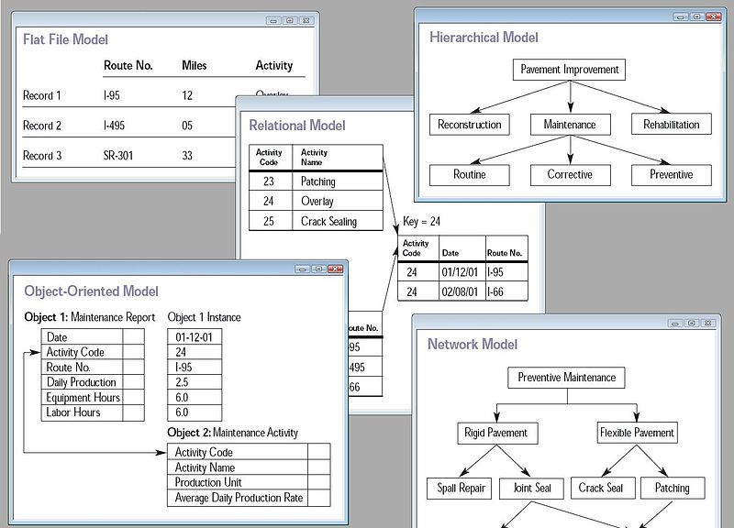
Database Model

Slide 28
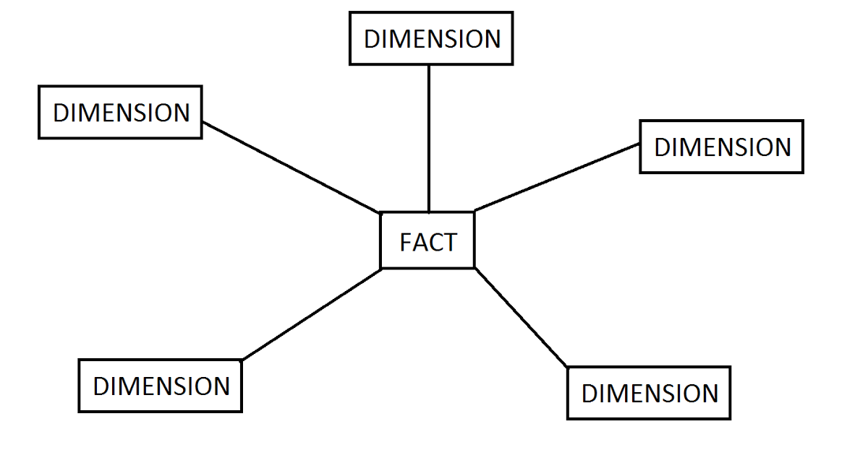
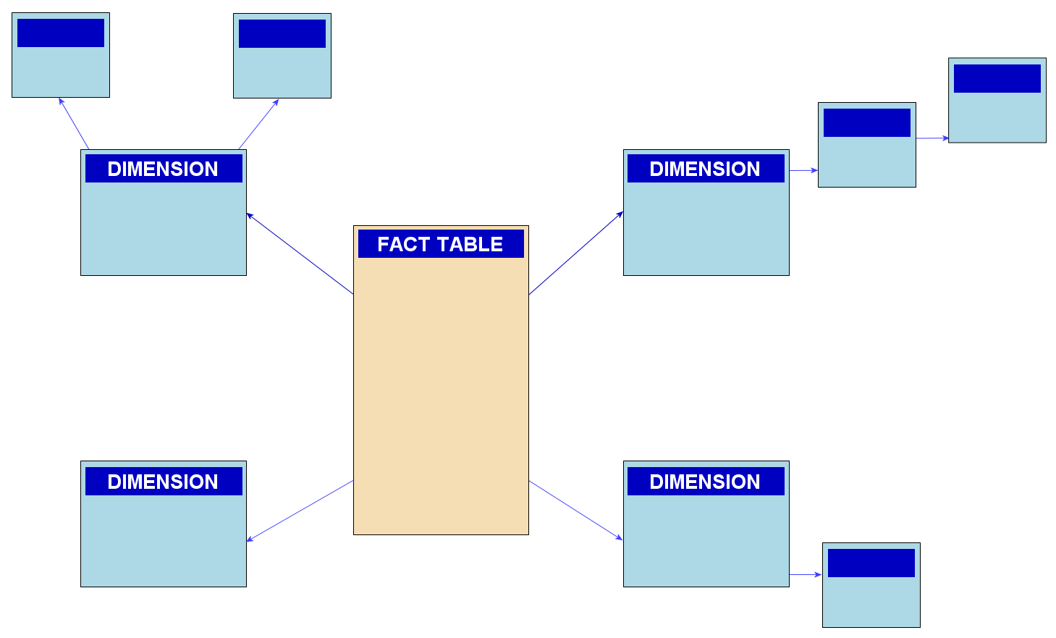
Relational Model
Star Schema
Snowflake Schema

Slide 29
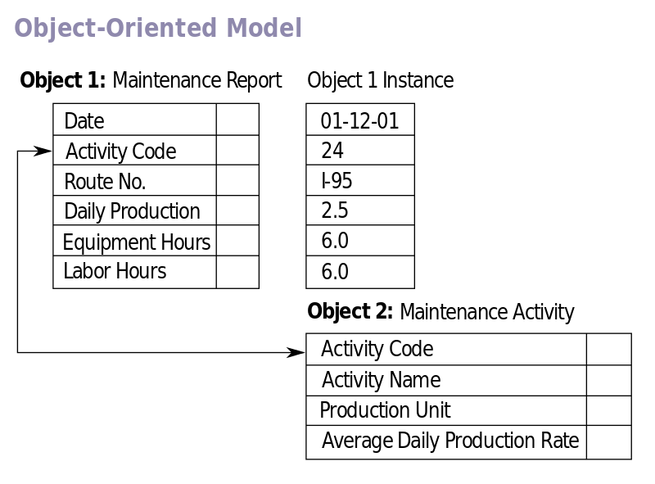
Object-oriented database models

Slide 30
Database Design Techniques
1. ER Modeling (Top down Approach)
Entity Relationship Diagram, also known as ERD, ER Diagram or ER model, is a type of structural diagram for use in database design. An ERD contains different symbols and connectors that visualize two important information: The major entities within the system scope, and the inter-relationships among these entities.
2. Normalization (Bottom Up approach)
Database Normalization is a technique of organizing the data in the database. Normalization is a systematic approach of decomposing tables to eliminate data redundancy(repetition) and undesirable characteristics like Insertion, Update and Deletion Anomalies. It is a multi-step process that puts data into tabular form, removing duplicated data from the relation tables

Slide 31
Normalization Rule
Normalization rules are divided into the following normal forms:
First Normal Form
Second Normal Form
Third Normal Form
BCNF
Fourth Normal Form

Slide 32
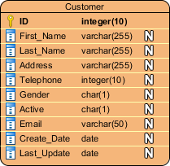
ERD notations
Entity
An ERD entity is a definable thing or concept within a system, such as a person/role (e.g. Student), object (e.g. Invoice), concept (e.g. Profile) or event (e.g. Transaction) (note: In ERD, the term "entity" is often used instead of "table", but they are the same)
Entity Attributes
Also known as column, an attribute is a property or characteristic of the entity that holds it.

Slide 33
ERD notations
Relationship
A relationship between two entities signifies that the two entities are associated with each other somehow. For example, student might enroll into a course. The entity Student is therefore related with Course, and the relationships is presented as a connector connecting between them.

Slide 34


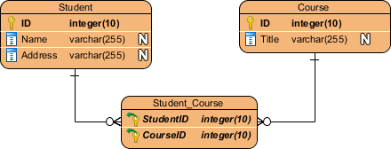
ERD notations
Cardinality
Cardinality defines the possible number of occurrence in one entity which are associated to the number of occurrences in another. For example, ONE team has MANY players. When present in an ERD, the entities Team and Player are inter-connected with a one-to-many relationship.
In an ER diagram, cardinality is represented as a crow's foot at the connector's ends. The three common cardinal relationships are one-to-one, one-to-many, and many-to-many.
one-to-one | one-to-many | many-to-many

Slide 35
Assignment
Create an ER diagram based on tables that are described in Normalization section.

Slide 36
Q & A

